Slide 1
MY SQL

Slide 2
Introduction to MYSQL
Getting started with MySQL and GUI tool
Fundamentals of RDBMS and database designs
Data Retrieval Technique
Data Modification Technique

Slide 3
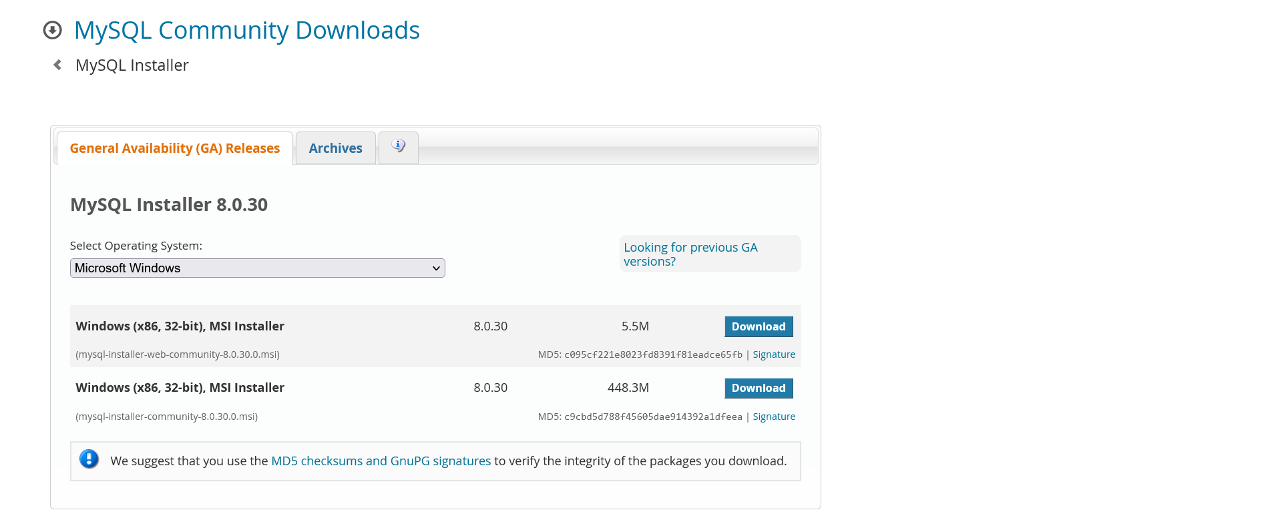
Introduction to MySQL
You can download MySQL from this given link
http://dev.mysql.com/downloads/

Slide 4

Once installed it just try with password root

Slide 5
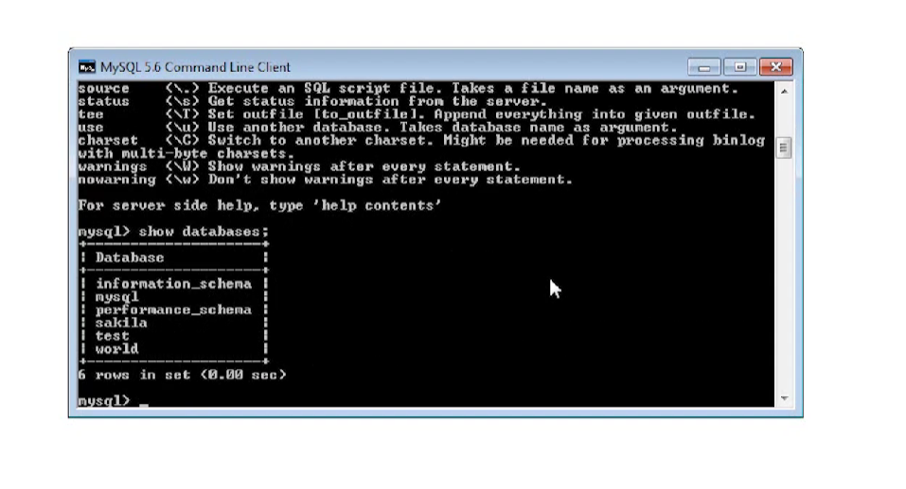
Show databases;

Slide 6
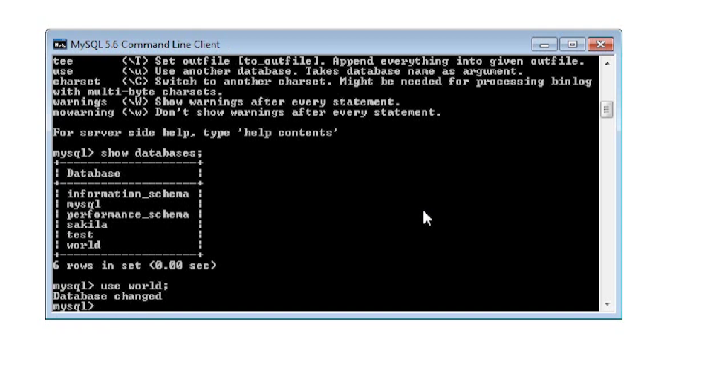
Use database_name;

Slide 7

Show tables;

Slide 8
Data Retrieval Techniques
Basic of SELECT statement:
SELECT Column_List
FROM Table_Name
WHERE Filter_Condition
ORDER BY Column_list
LIMIT Row_limit

Slide 9
Beginning SELECT statement
Retrieve Static value
Retrieve all the data from table
Retrieve all the data by single column
Retrieve selected column from table
Retrieve the data with filter condition
Retrieve empty result set

Slide 10
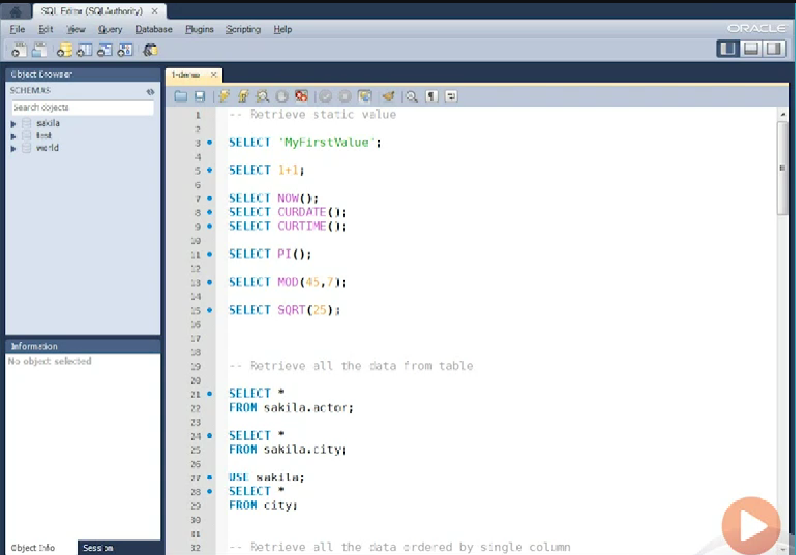
Let’s start with simple example:

Slide 11
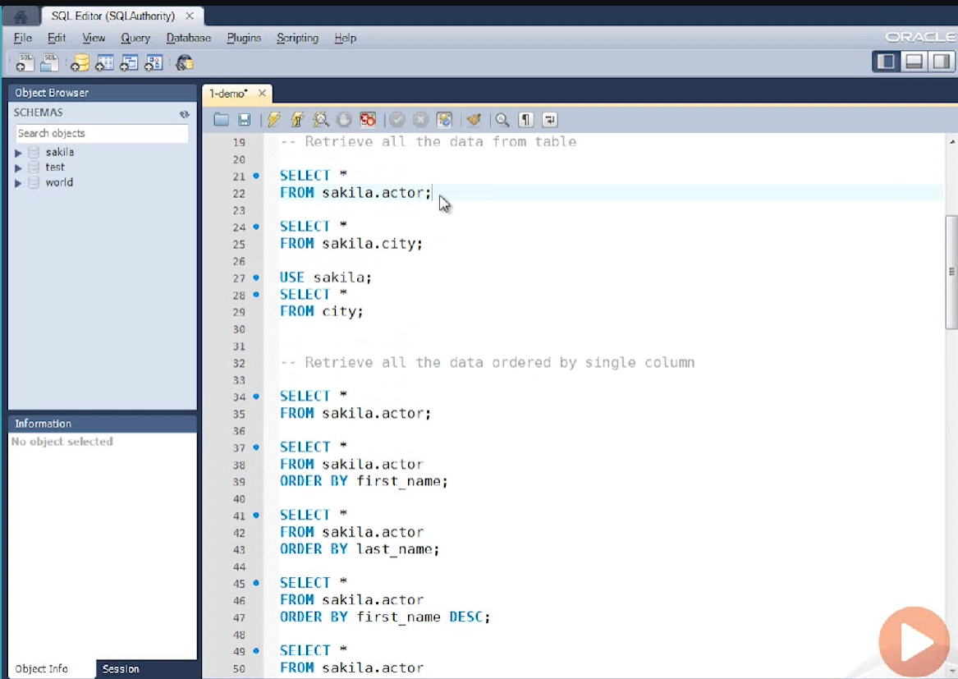
Retrieve data from table

Slide 12
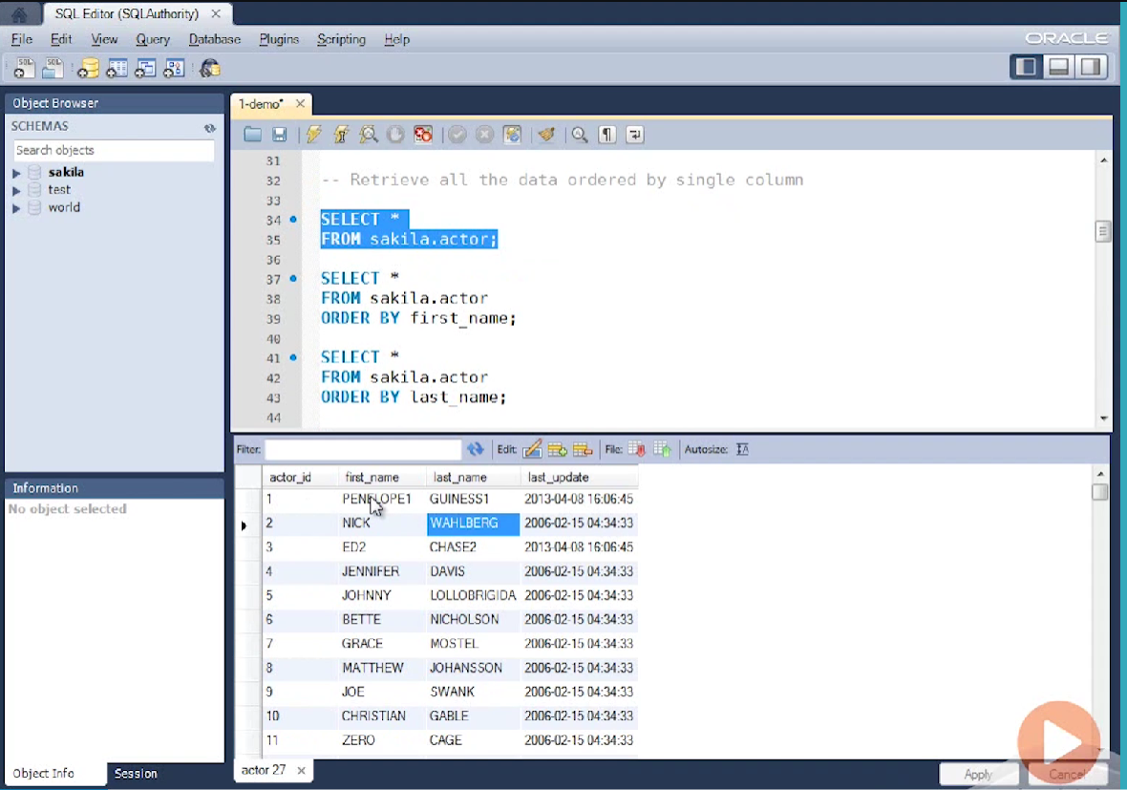

Slide 13
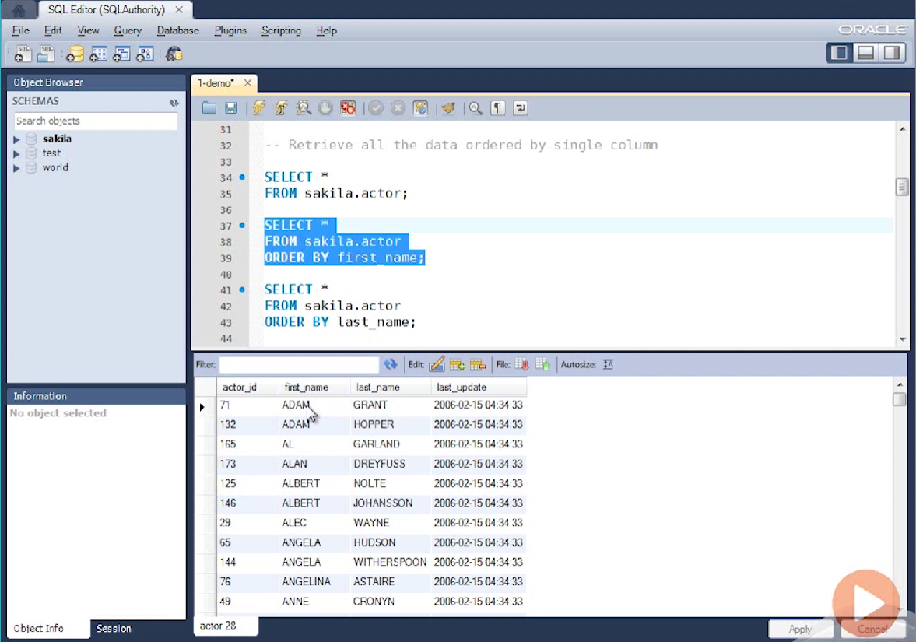
Retrieve all the data ordered by single column

Slide 14
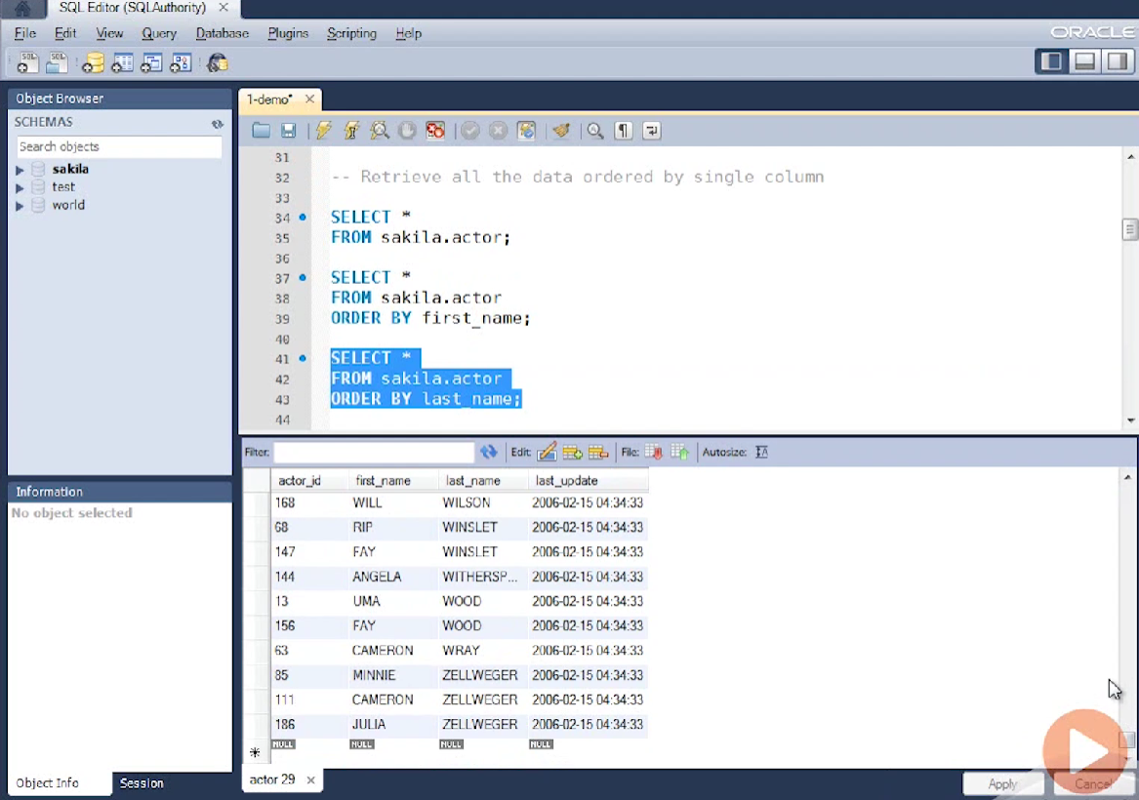
Oreder by last_name

Slide 15
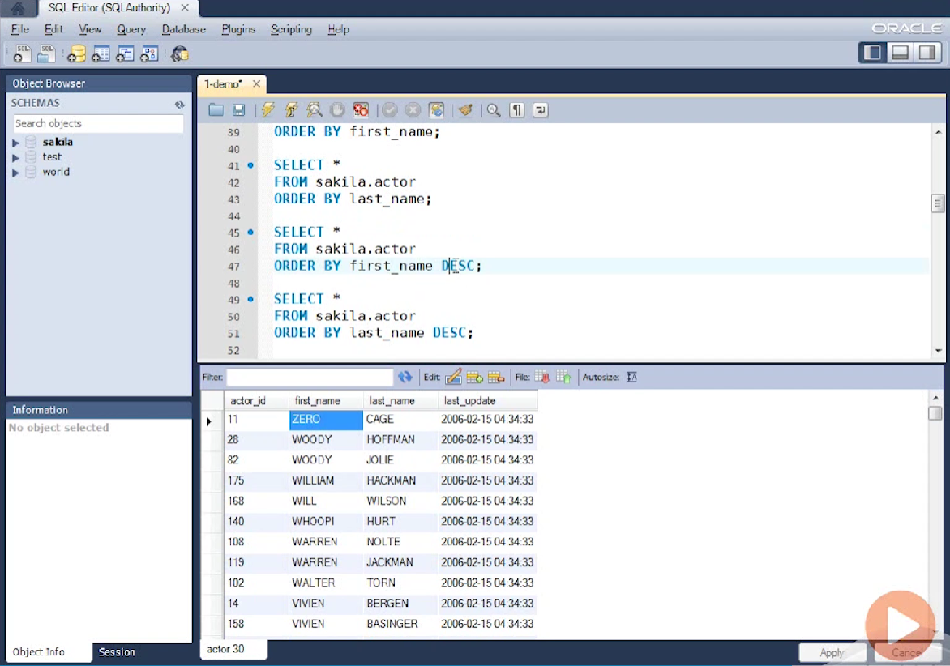
Order by descending

Slide 16
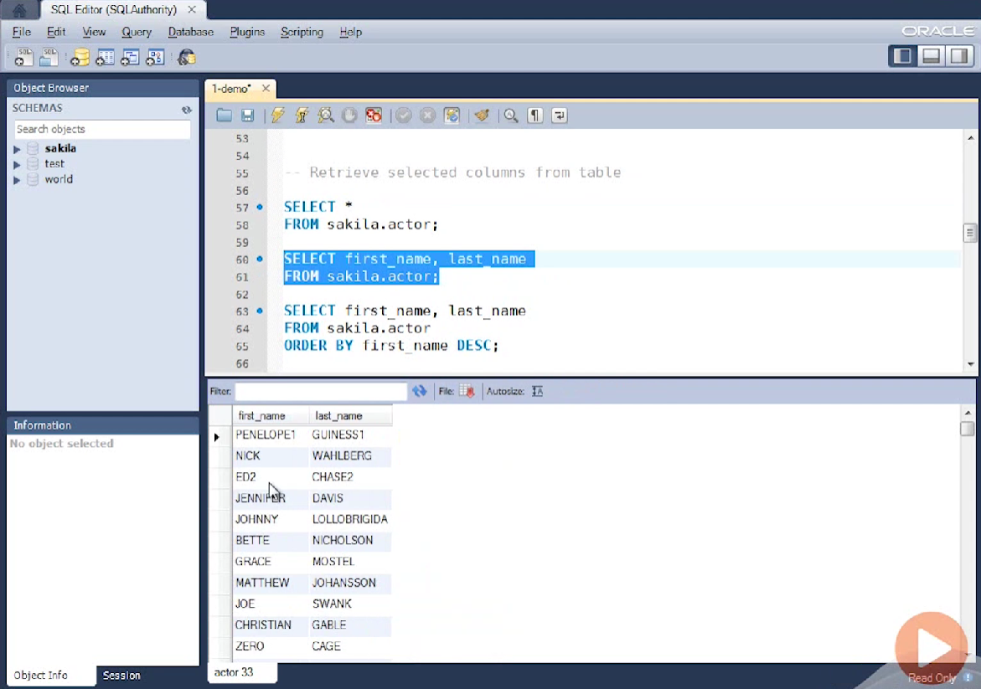
Retrieve selected columns from table

Slide 17
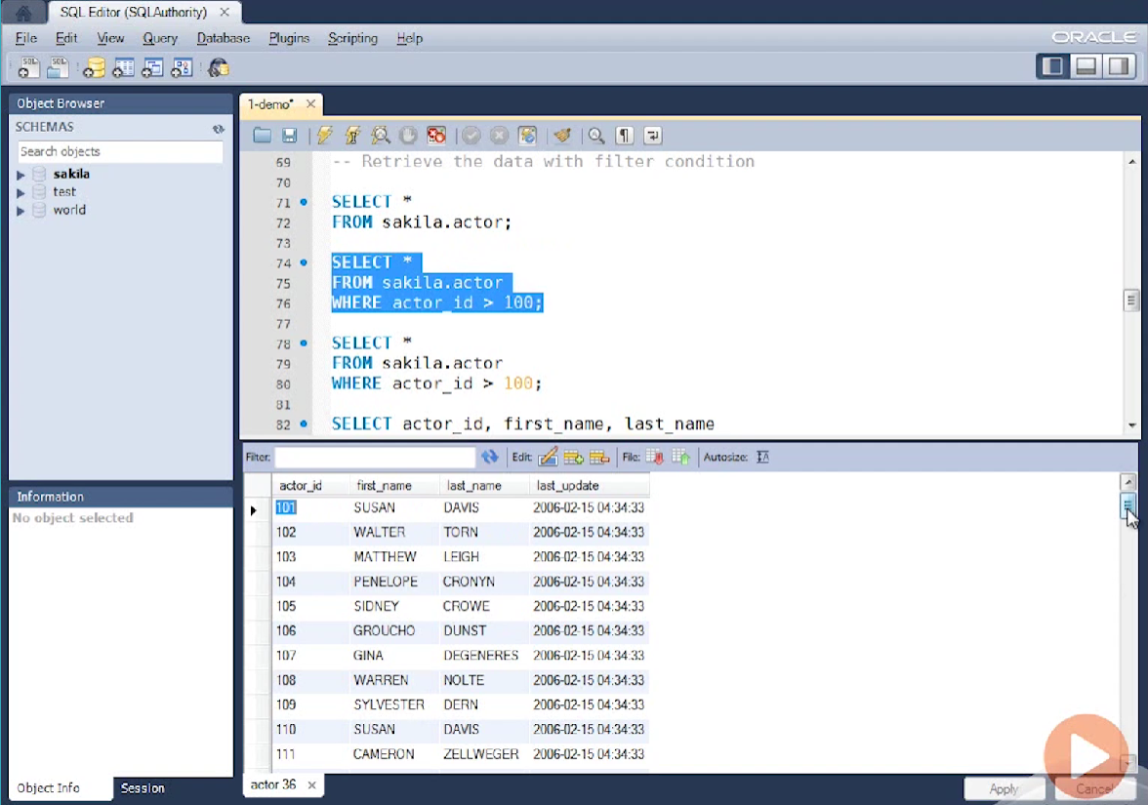
Retrieve from rows

Slide 18
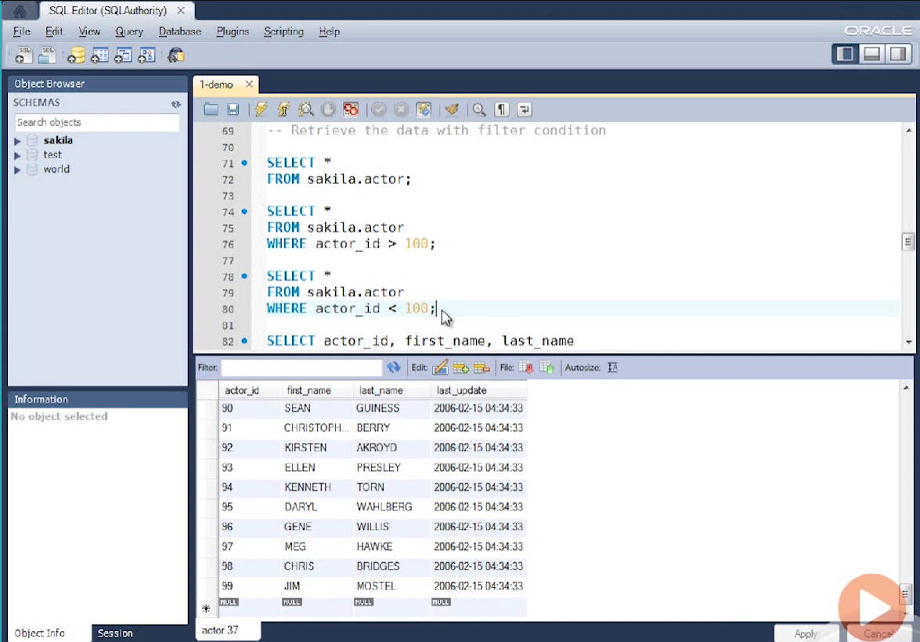

Slide 19
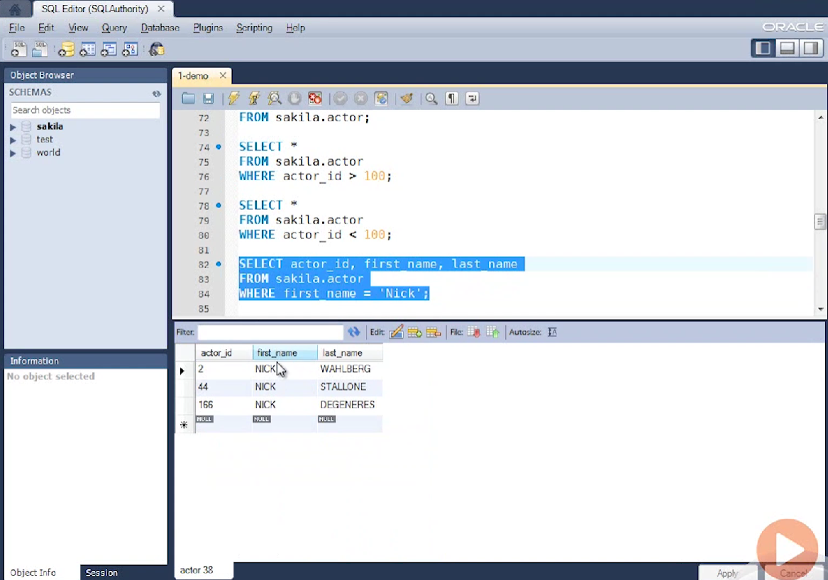

Slide 20
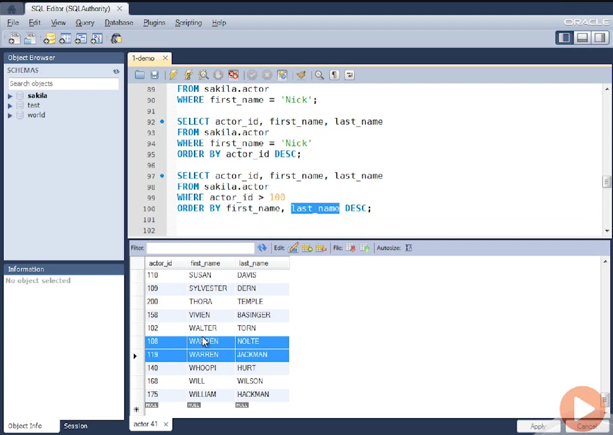

Slide 21
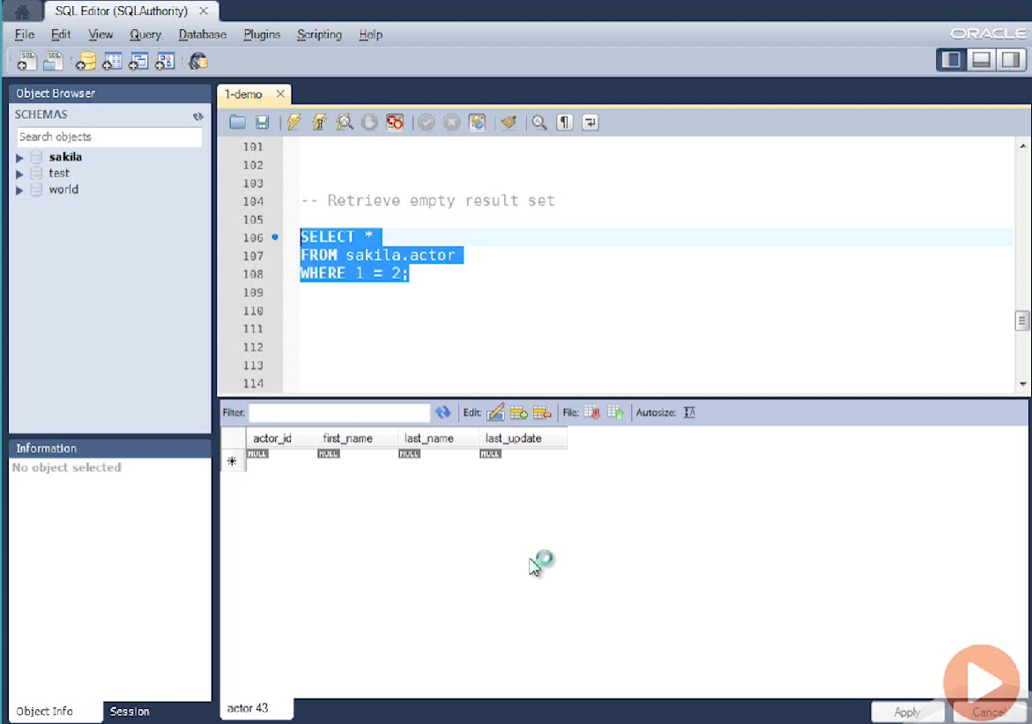
Retrieve empty result set

Slide 22
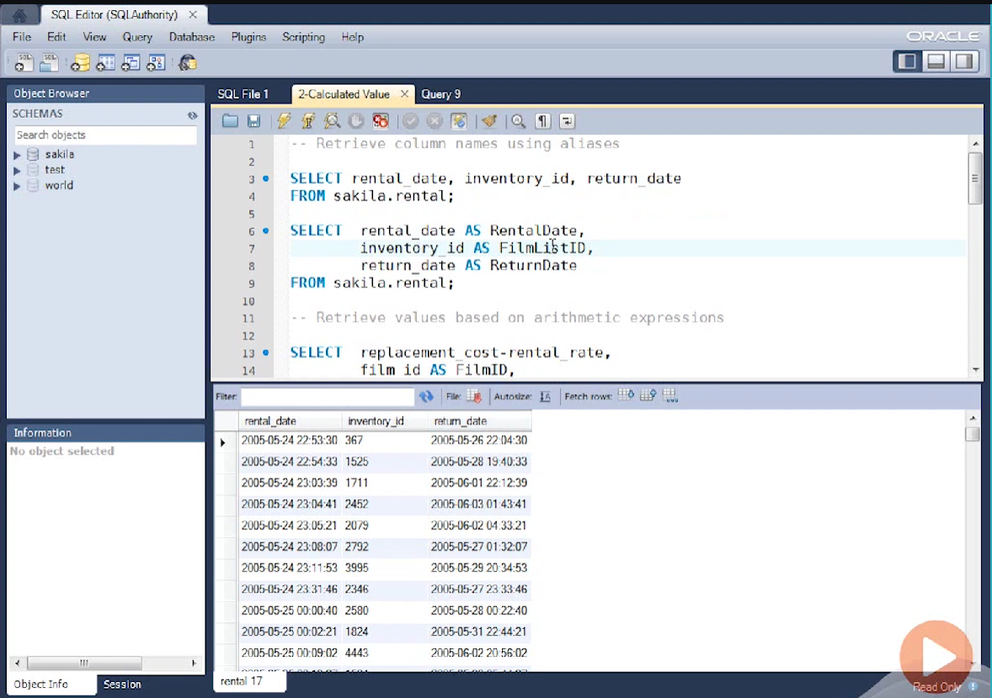
Retrieve column name using aliases

Slide 23

Retrieve values on the base of arithmetic expression

Slide 24
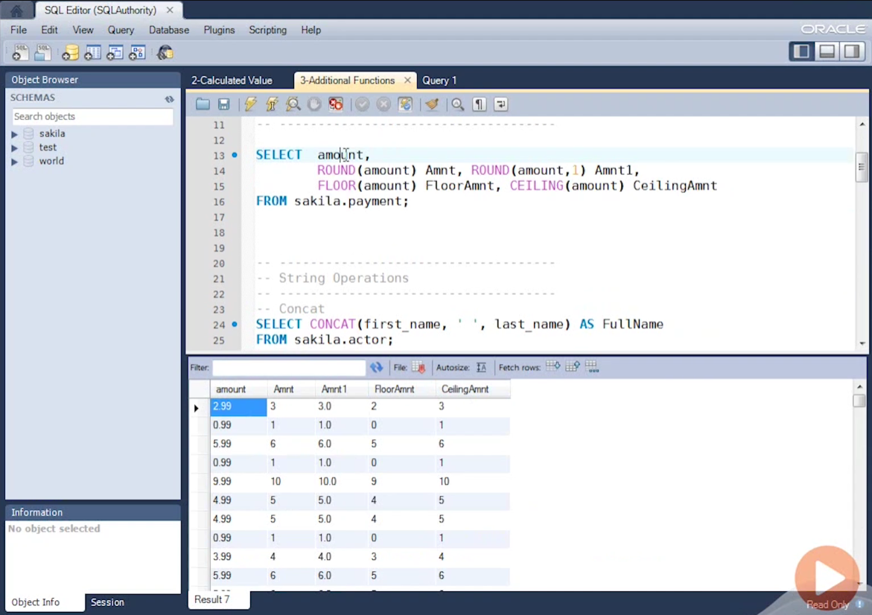
Additional function

Slide 25
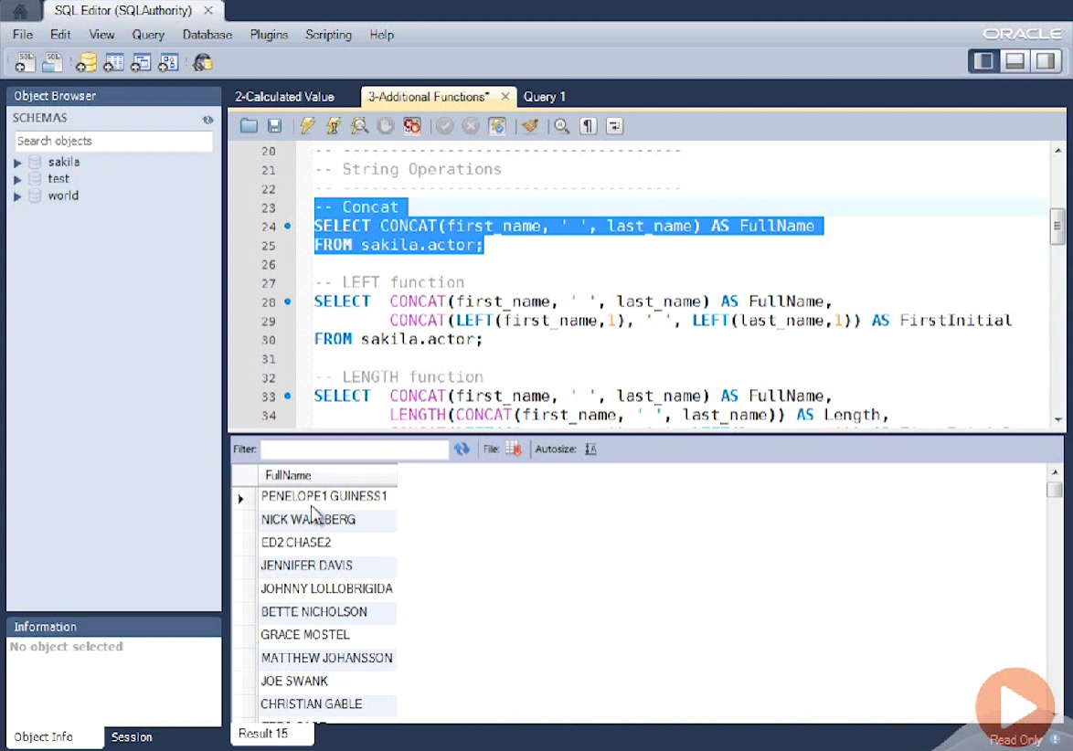
Concat two strings

Slide 26
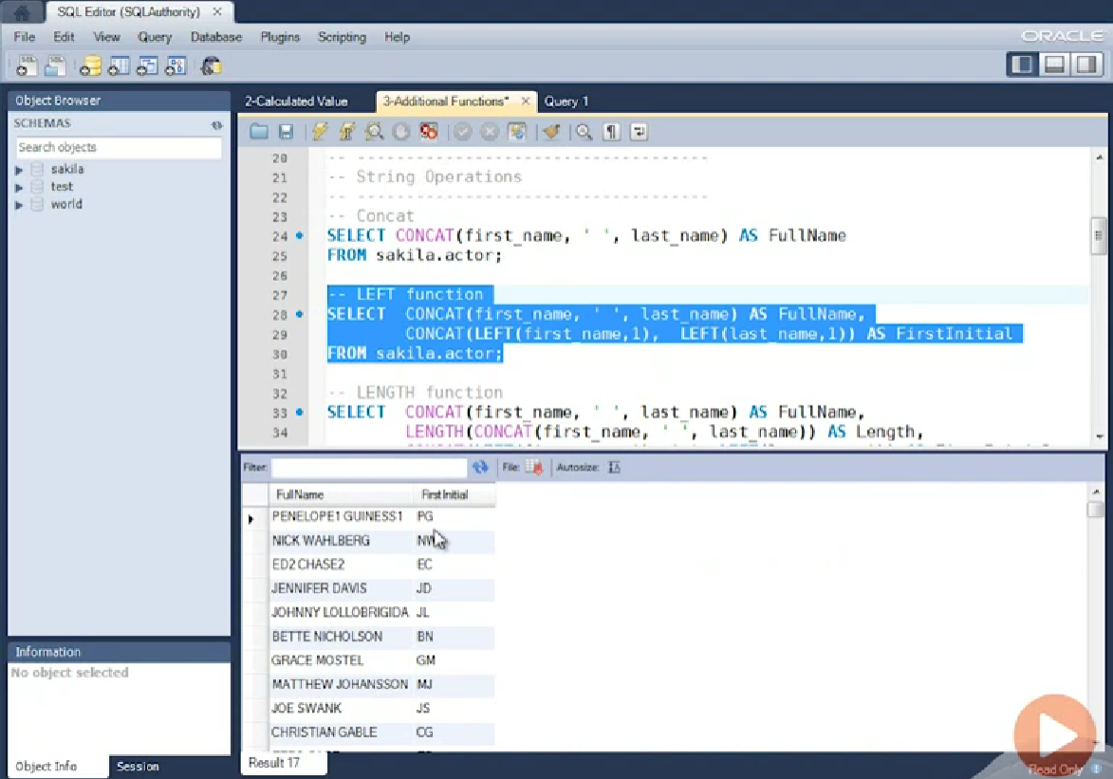
Left function

Slide 27
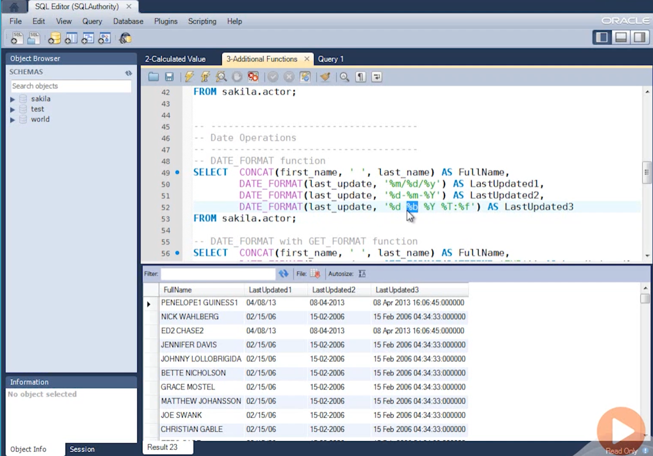
Date operation

Slide 28
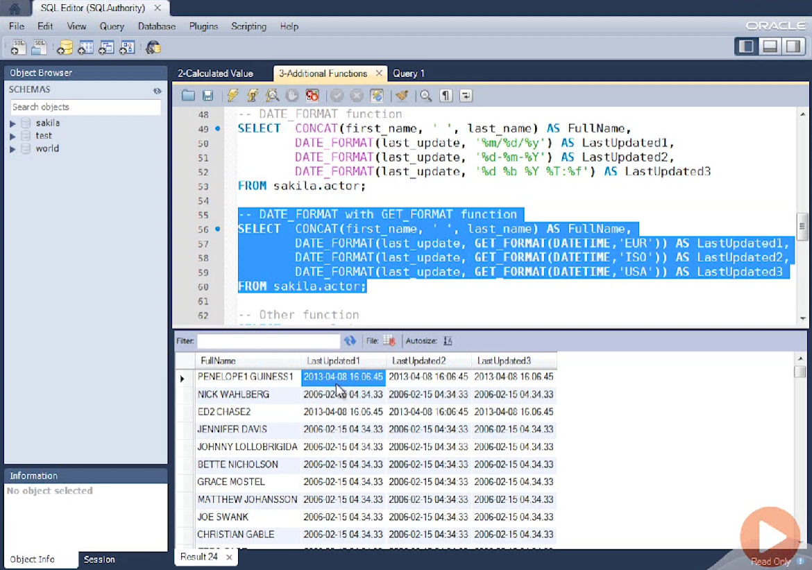

Slide 29
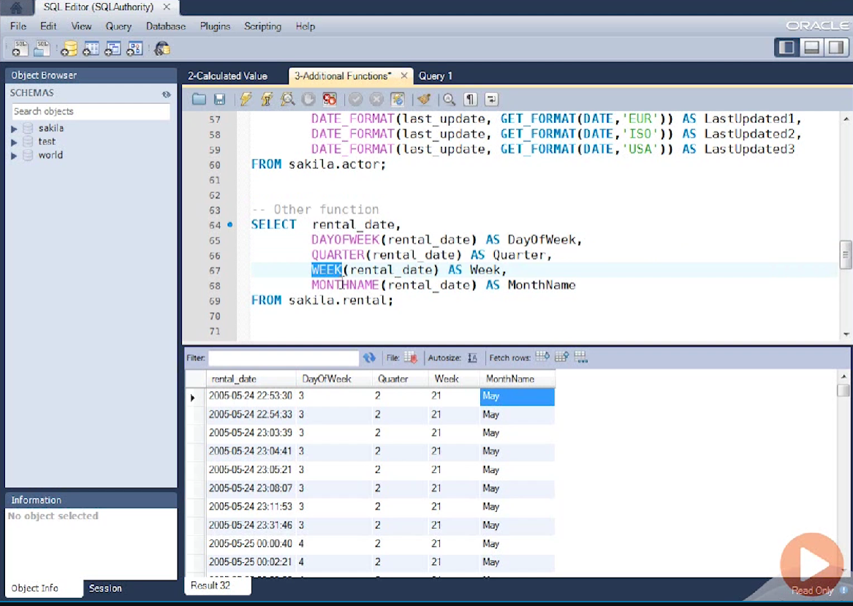

Slide 30
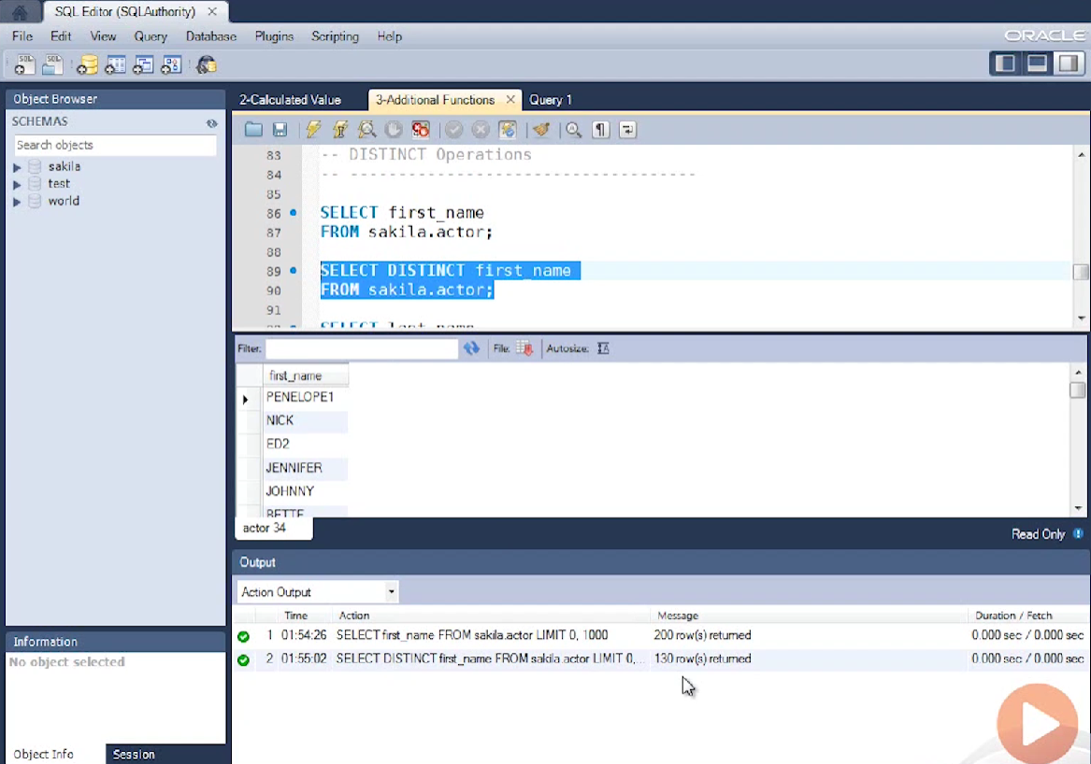
Distinct operation

Slide 31
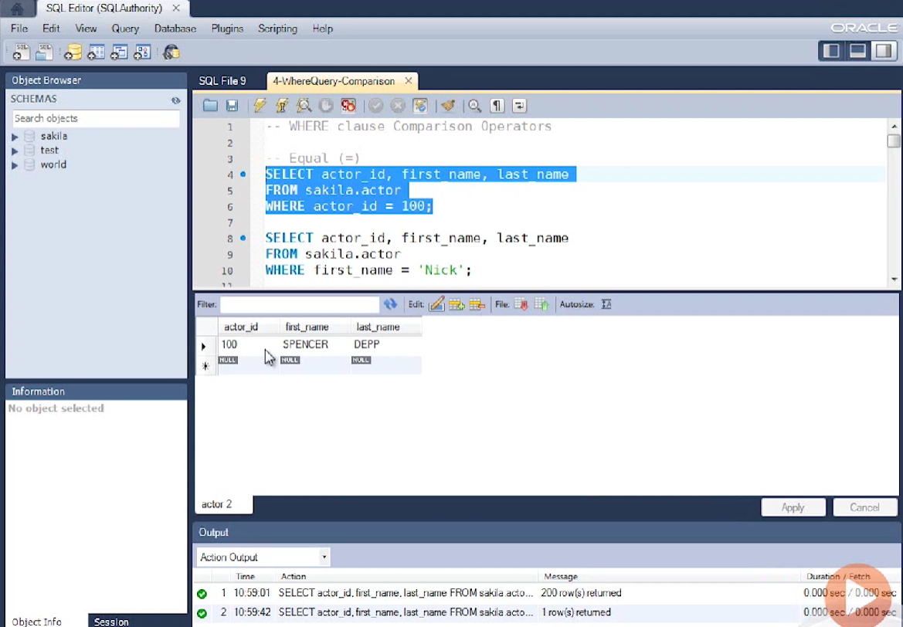
Where clause comparison operator

Slide 32
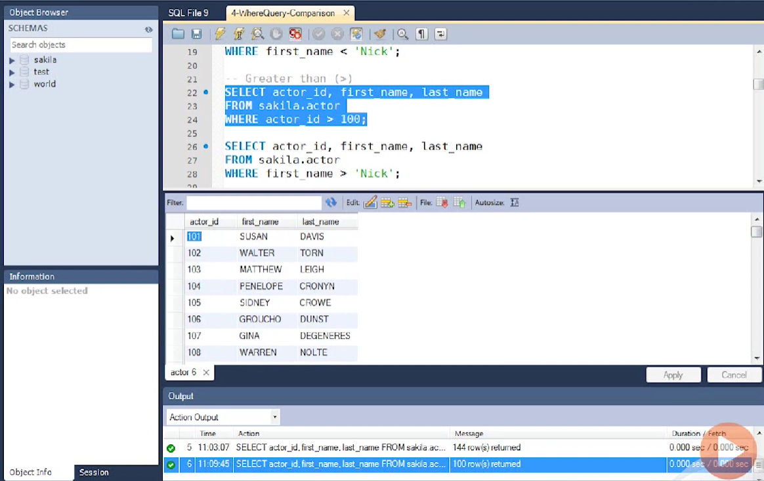

Slide 33
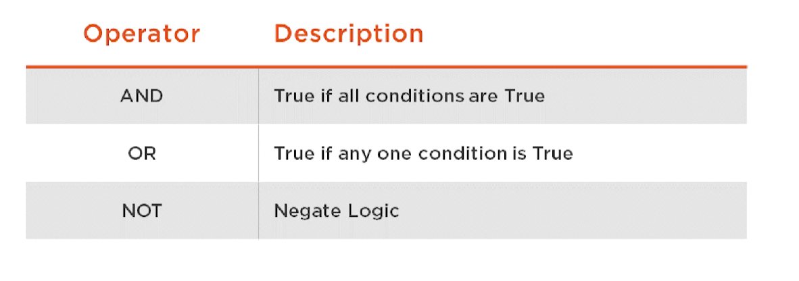
WHERE clause logical operator

Slide 34
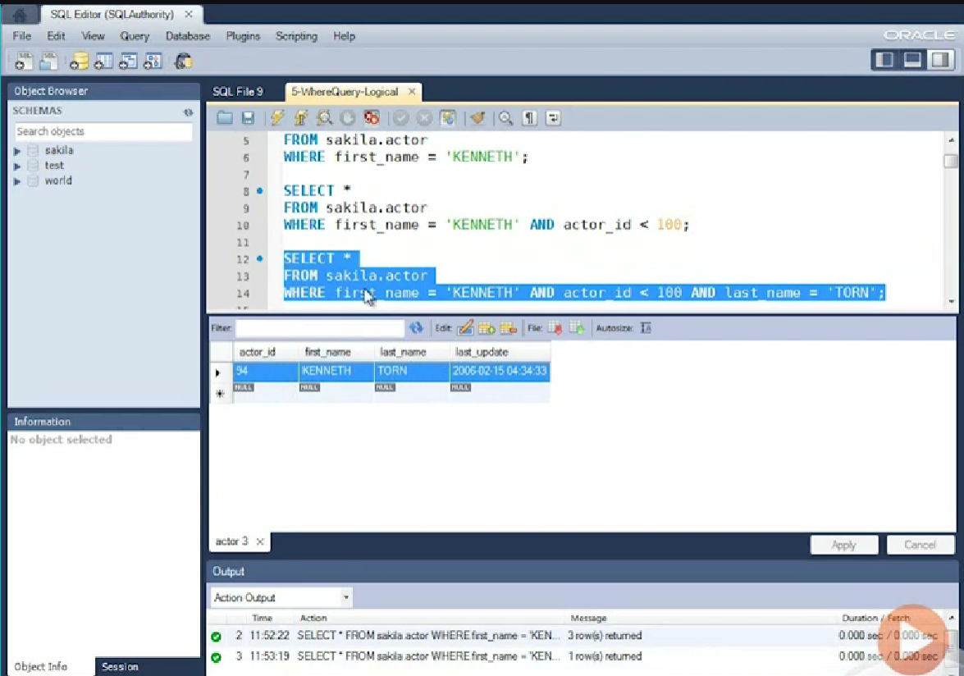

Slide 35
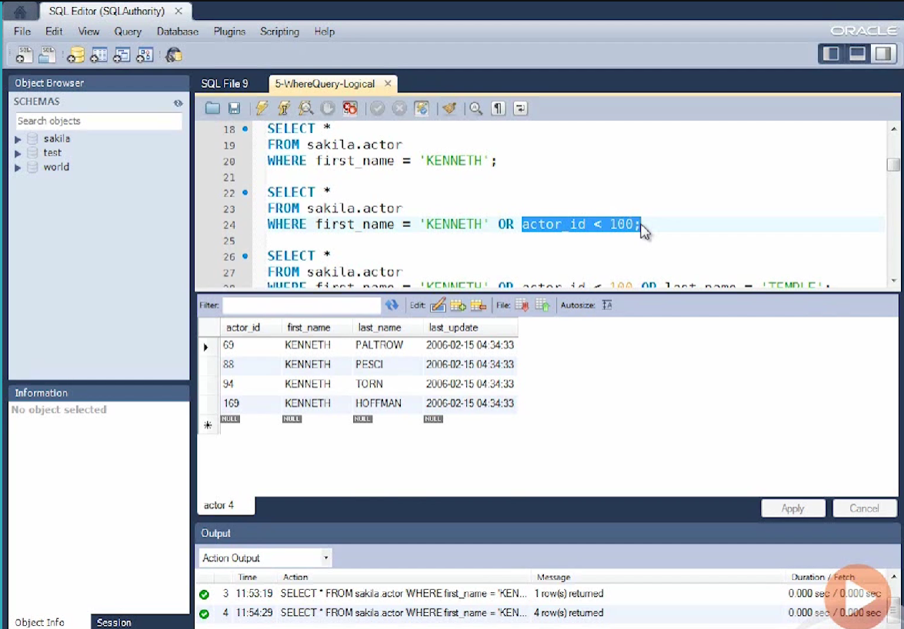

Slide 36
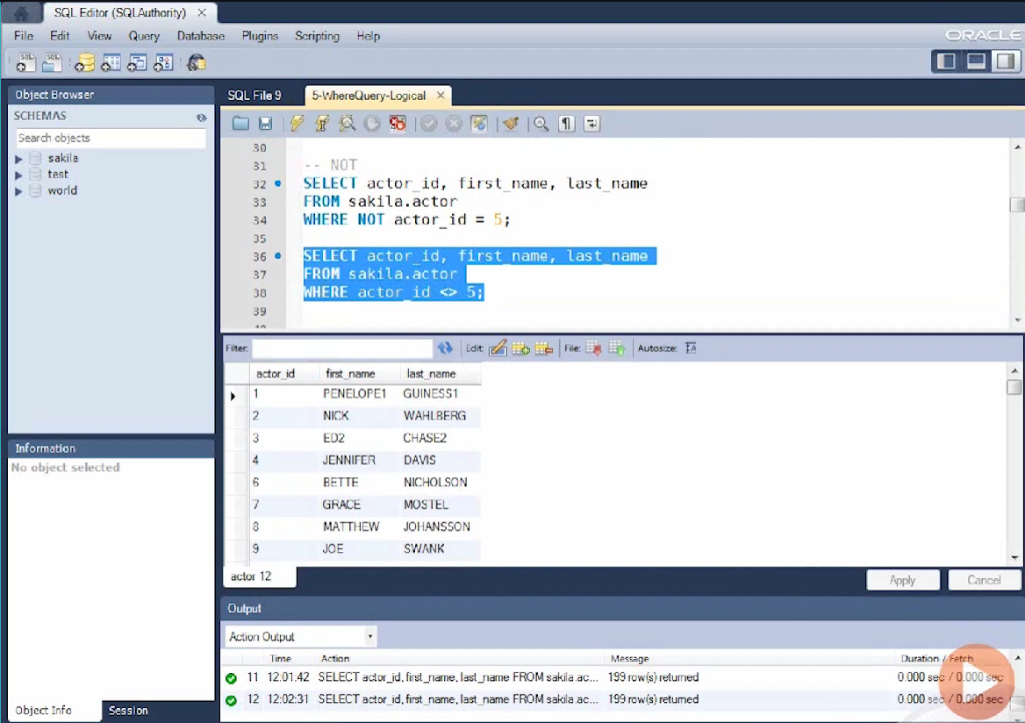

Slide 37
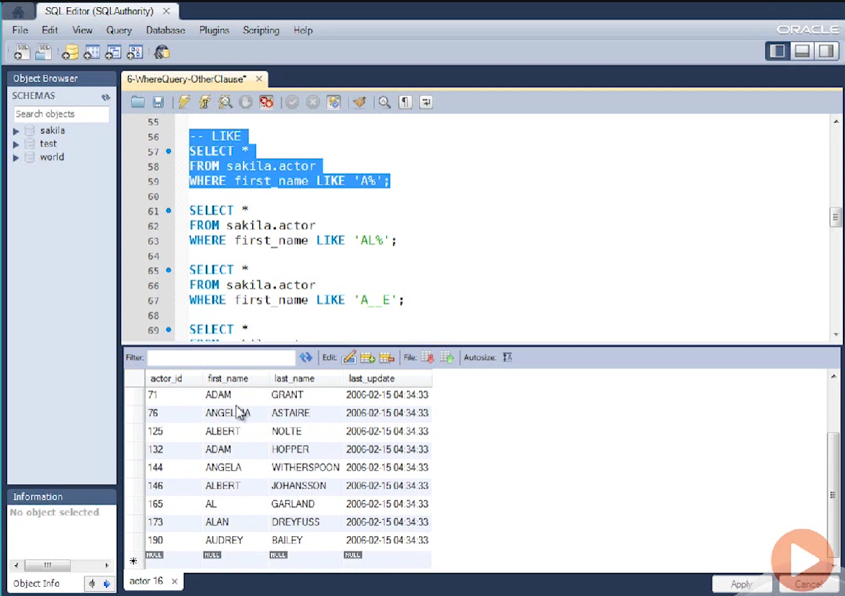
Like operator

Slide 38
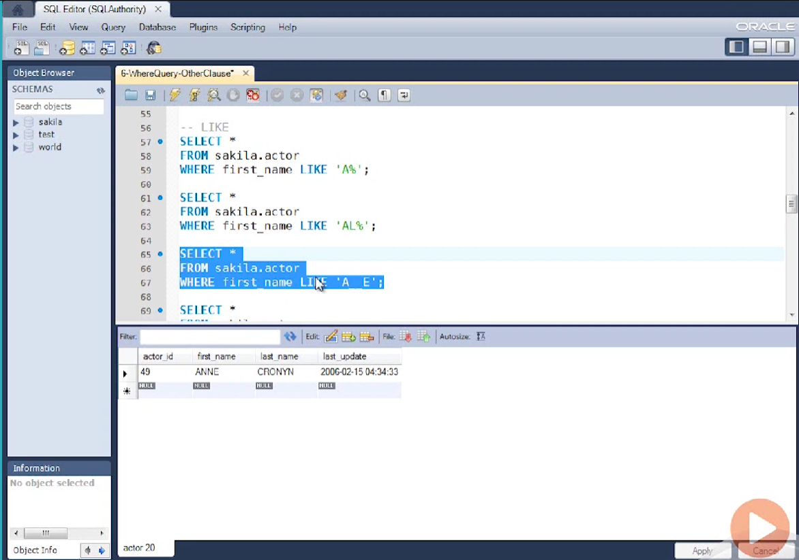

Slide 39
Order by clause
Sequence ascending descending
Single Column
Multi Column
Expression
Alias
Column Number

Slide 40
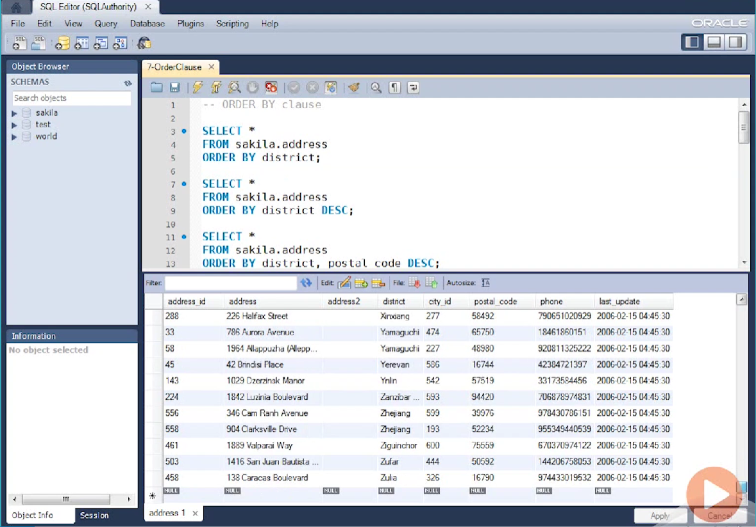

Slide 41
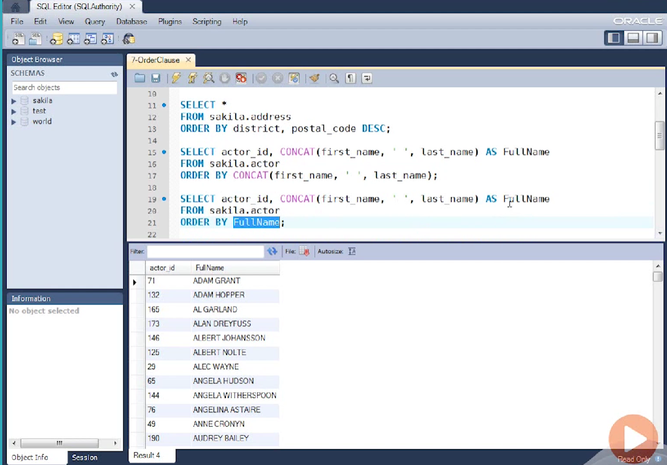

Slide 42
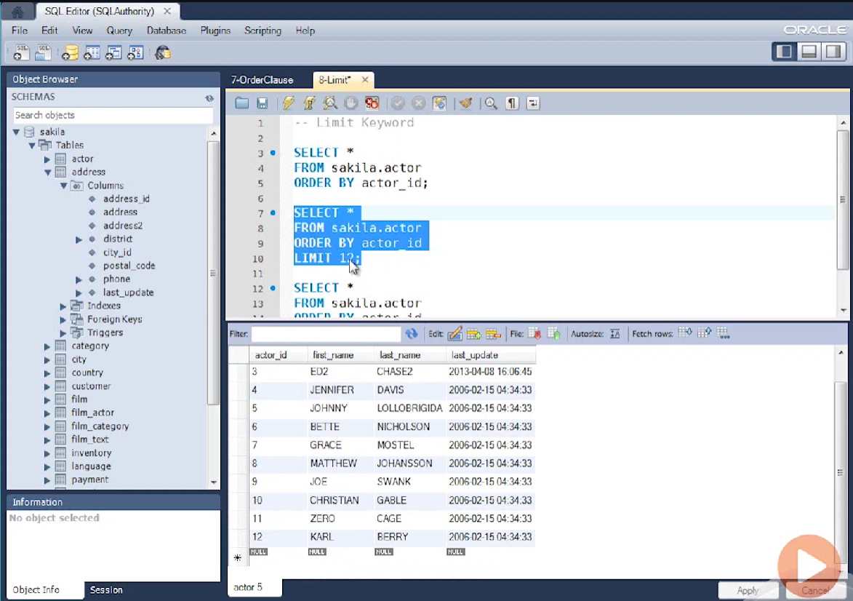
LIMIT operation

Slide 43
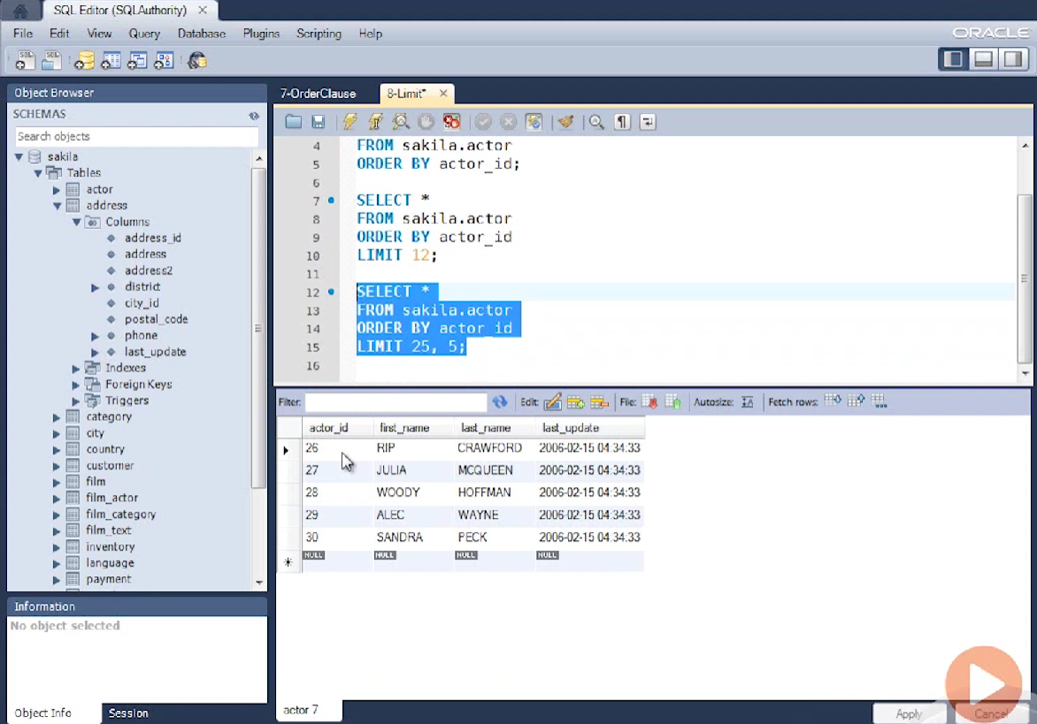

Slide 44
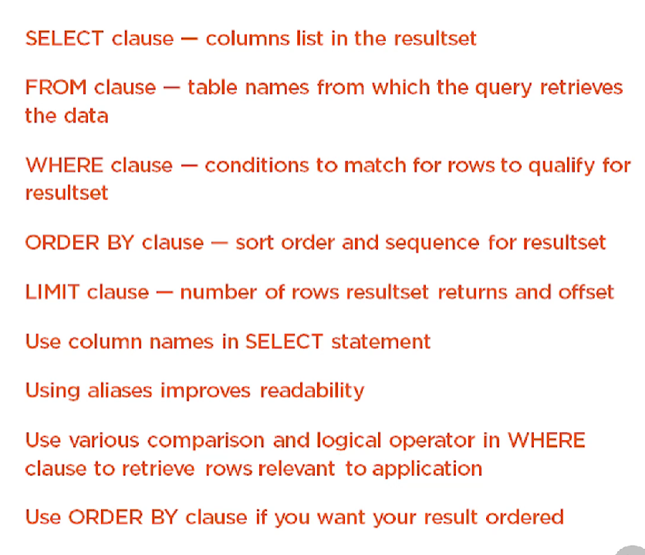

Slide 45
INSERT statement
UPDATE statement
DELETE statement

Slide 46
Insert statement
Single Row Insert using VALUES clause using SELECT statement
Multi row Insert using multiple VALUES clause using SELECT statement
Default values
Null values

Slide 47
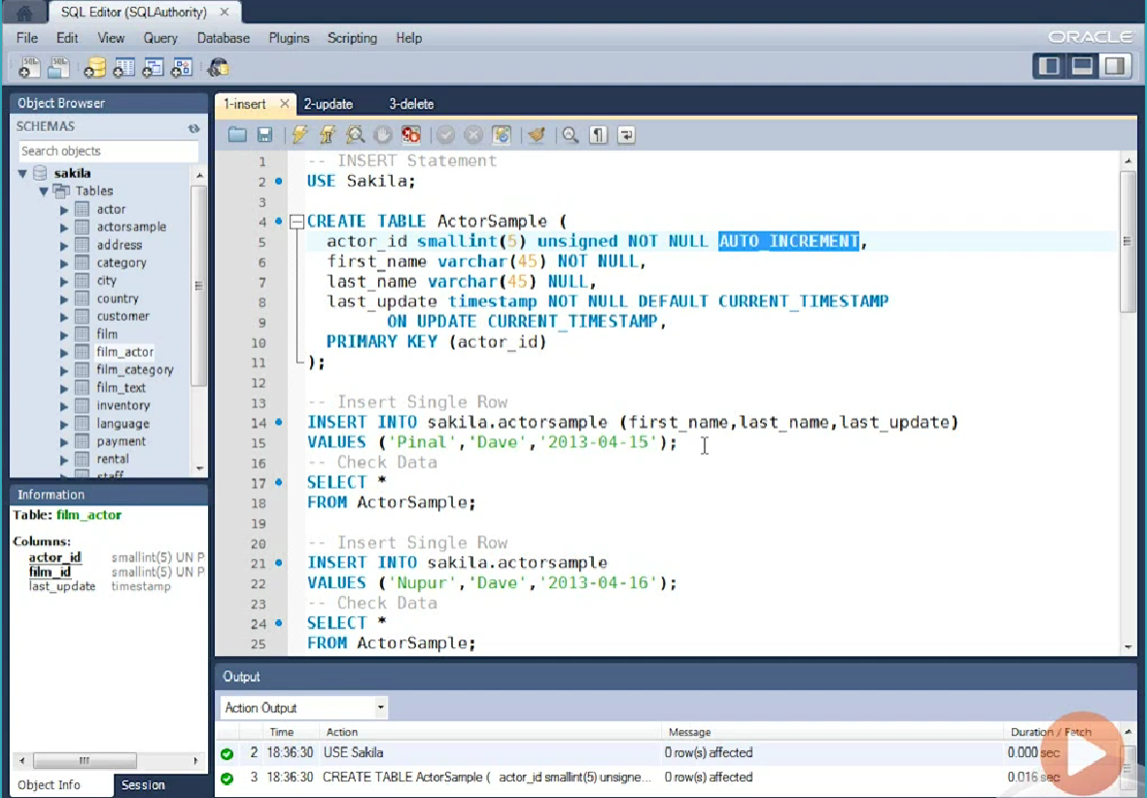

Slide 48
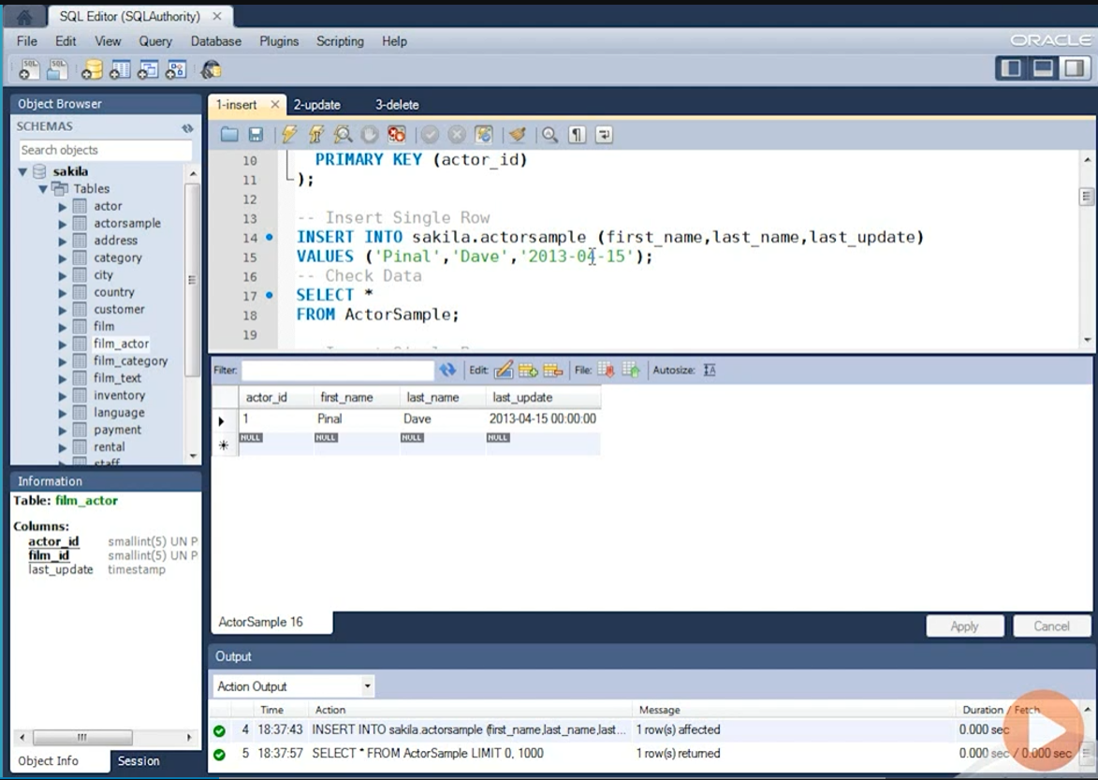

Slide 49
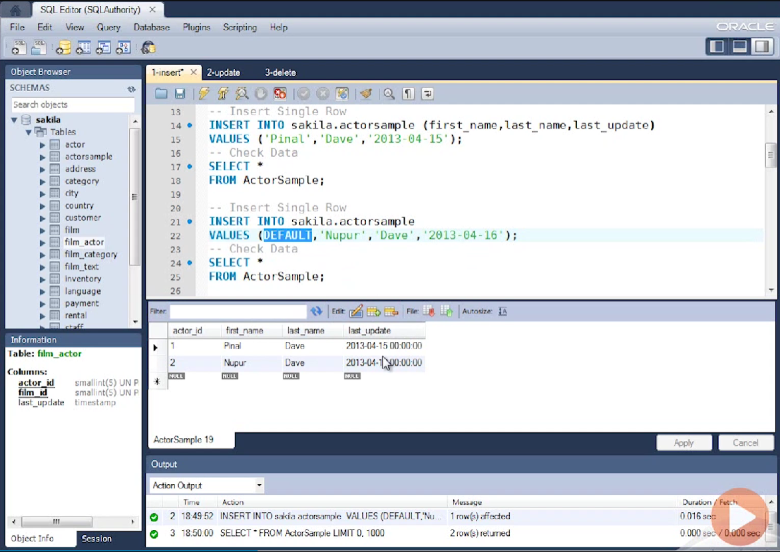

Slide 50
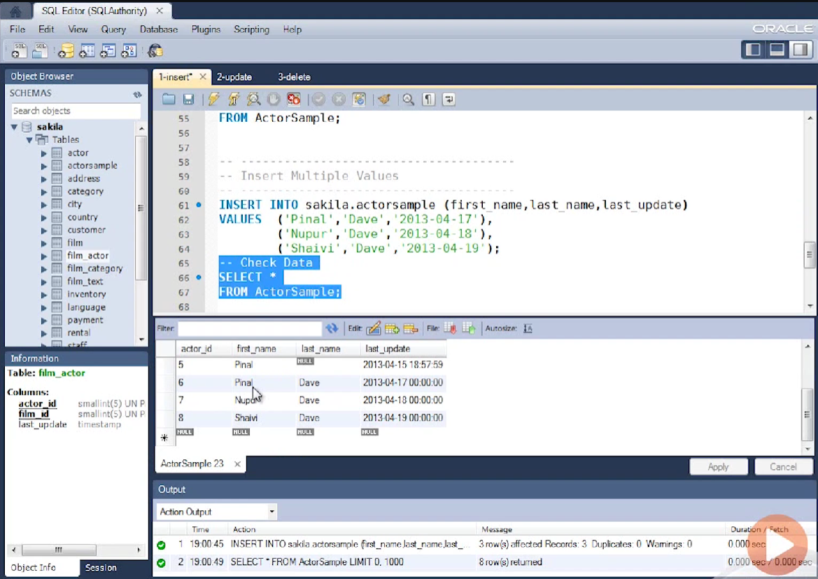

Slide 51
UPDATE statement
UPDATE using single row single column
UPDATE using single row multiple column
UPDATE using multiple row single column
UPDATE using multiple row multiple column
UPDATE using SELECT statement

Slide 52
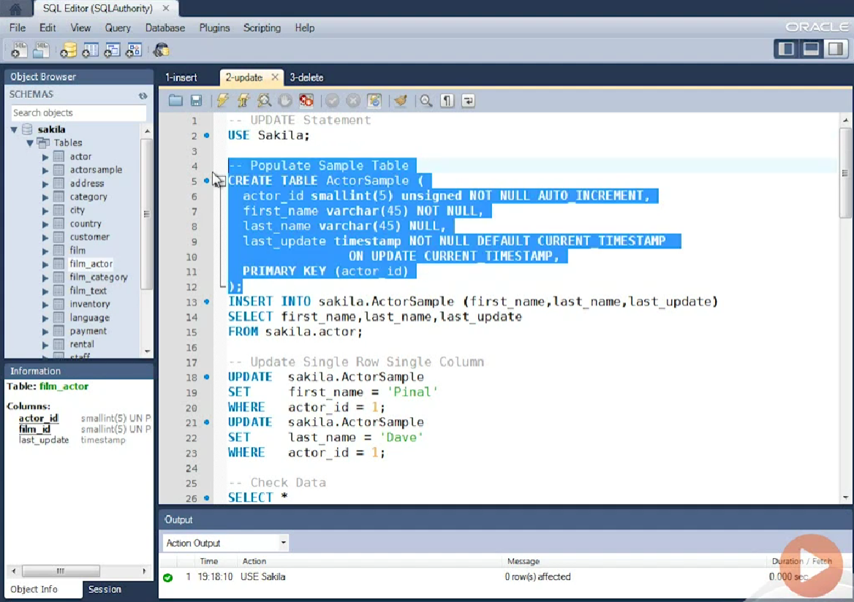

Slide 53
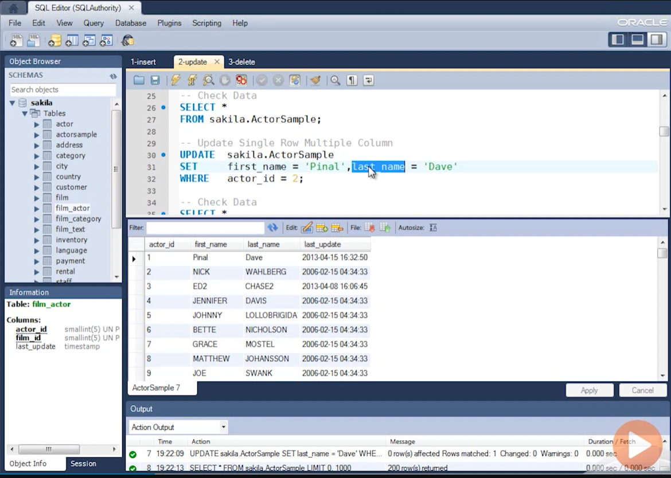

Slide 54
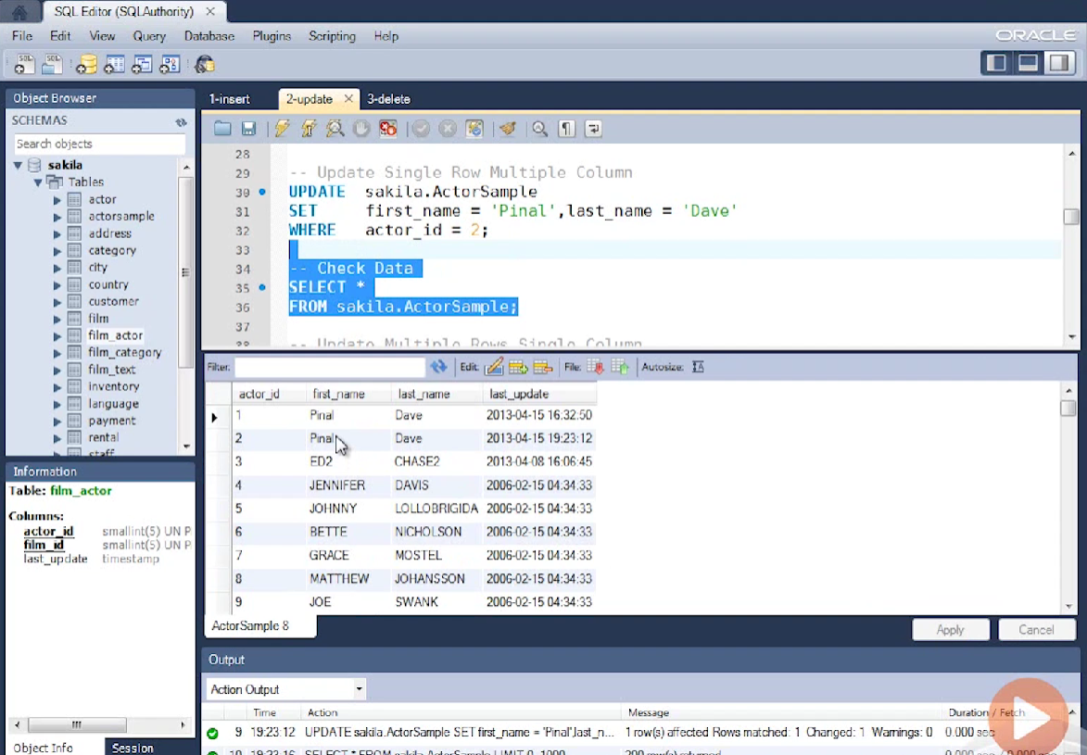

Slide 55
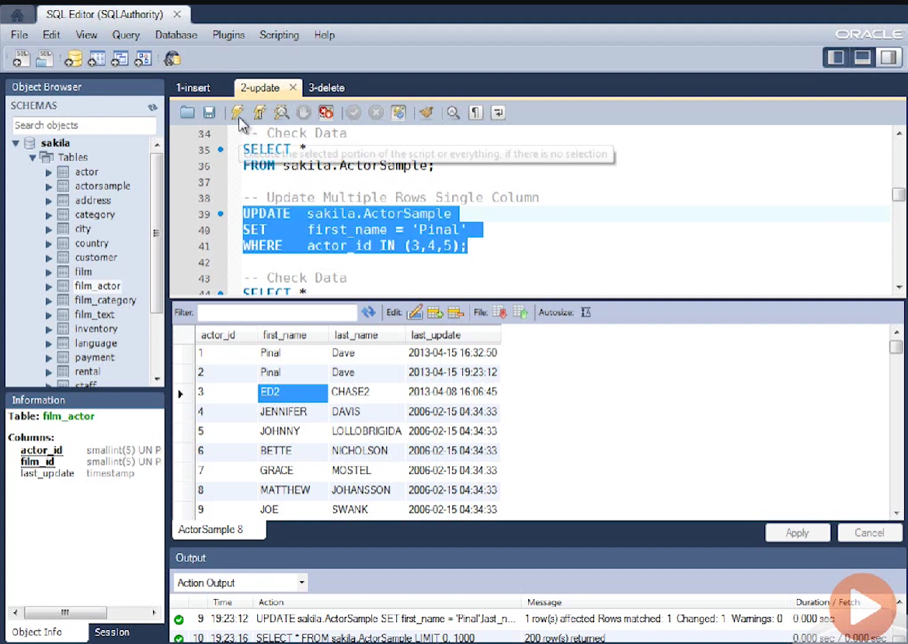

Slide 56
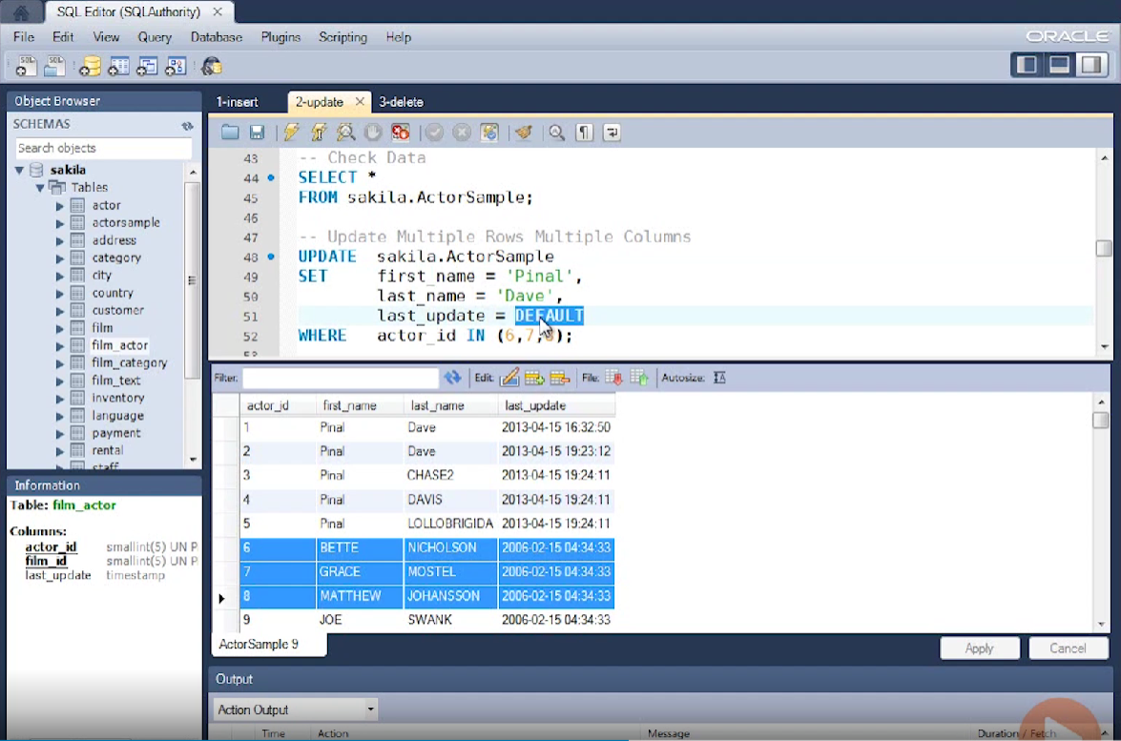

Slide 57
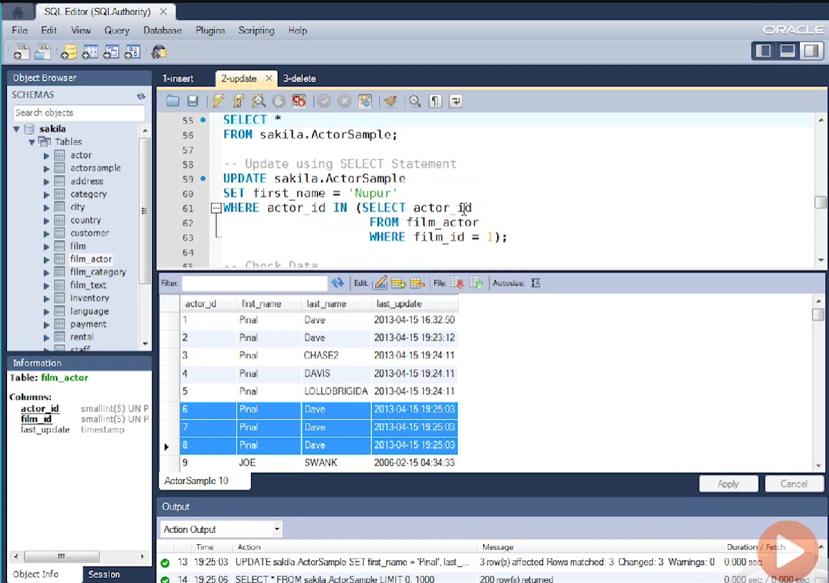

Slide 58
DELETE statement
DELETE single row
DELETE multiple rows
DELETE using SELECT statement
DELETE all rows from table

Slide 59
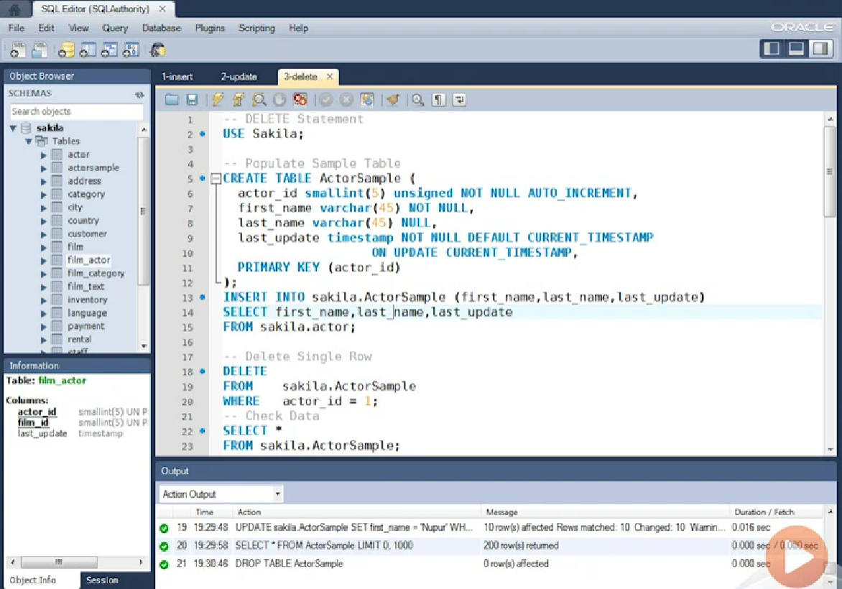

Slide 60
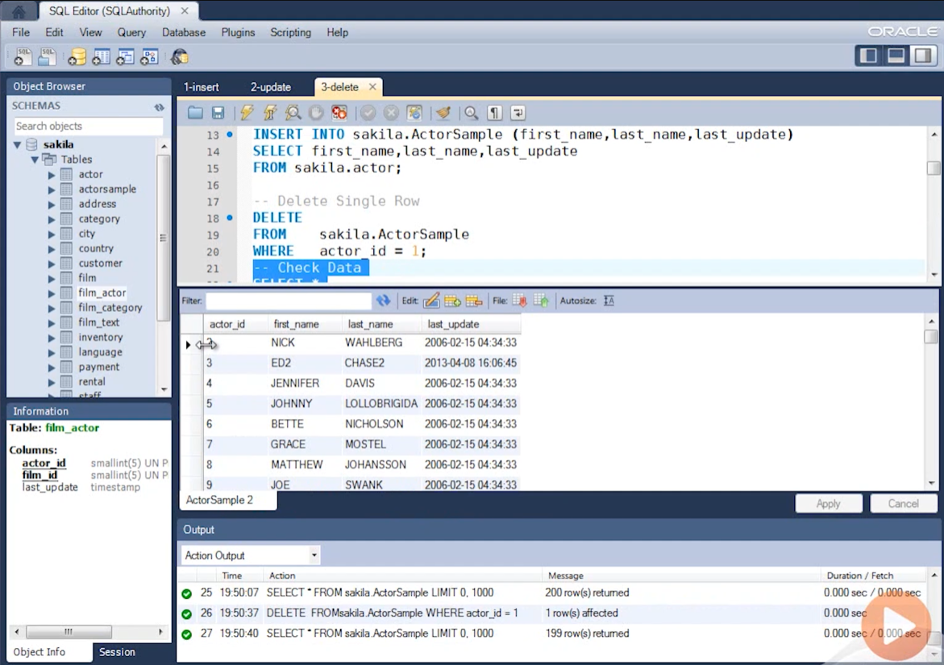

Slide 61
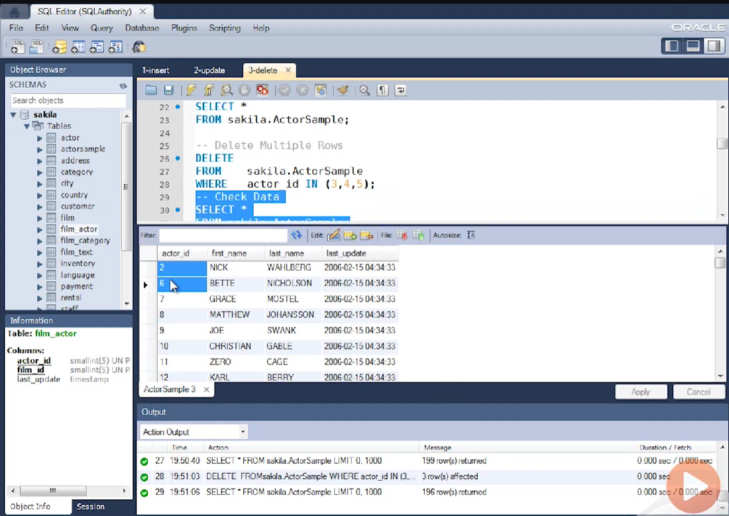

Slide 62
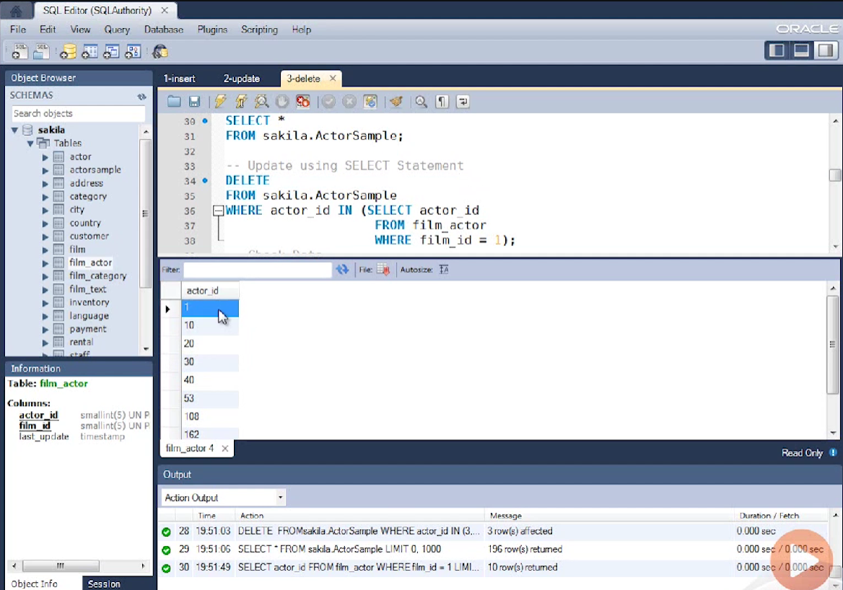

Slide 63


Slide 64


Slide 65
Use SELECT statement in subquery when inserting, updating or deleting
Multiple rows at a time.
Do not forget to specify WHERE clause in DELETE or UPDATE statement or it will modify your entire table.

Slide 66
Create Table
CREATE TABLE Table_Name (column_specifications)
Example
mysql> CREATE TABLE student
-> (
-> student_ID INT UNSIGNED NOT NULL,
-> name VARCHAR(20) NOT NULL,
-> major VARCHAR(50),
-> grade VARCHAR(5)
-> );
Query OK, 0 rows affected (0.00 sec)

Slide 67

Insert Record
INSERT INTO table_name SET col_name1=value1, col_name2=value2, col_name3=value3, …
Example:
mysql> INSERT INTO student SET student_ID=101, name='Shannon', major='BCB', grade='A’;
Query OK, 1 row affected (0.00 sec)

Slide 68
MySQL Constrains
Create Constraints
Constraints can be specified when the table is created with the CREATE TABLE statement, or after the table is created with the ALTER TABLE statement.
Syntax
CREATE TABLE table_name ( column1 datatype constraint, column2 datatype constraint, column3 datatype constraint, .... );

Slide 69
MySQL Constraints
SQL constraints are used to specify rules for the data in a table.
Constraints are used to limit the type of data that can go into a table. This ensures the accuracy and reliability of the data in the table. If there is any violation between the constraint and the data action, the action is aborted.
Constraints can be column level or table level. Column level constraints apply to a column, and table level constraints apply to the whole table.

Slide 70
The following constraints are commonly used in SQL:
NOT NULL - Ensures that a column cannot have a NULL value
UNIQUE - Ensures that all values in a column are different
PRIMARY KEY - A combination of a NOT NULL and UNIQUE. Uniquely identifies each row in a table
FOREIGN KEY - Prevents actions that would destroy links between tables
CHECK - Ensures that the values in a column satisfies a specific condition
DEFAULT - Sets a default value for a column if no value is specified

Slide 71
MySQL NOT NULL Constraint
By default, a column can hold NULL values.
The NOT NULL constraint enforces a column to NOT accept NULL values.
This enforces a field to always contain a value, which means that you cannot insert a new record, or update a record without adding a value to this field.
NOT NULL on CREATE TABLE
The following SQL ensures that the "ID", "LastName", and "FirstName" columns will NOT accept NULL values when the "Persons" table is created:
CREATE TABLE Persons ( ID int NOT NULL, LastName varchar(255) NOT NULL, FirstName varchar(255) NOT NULL, Age int );

Slide 72
NOT NULL on ALTER TABLE
To create a NOT NULL constraint on the "Age" column when the "Persons" table is already created, use the following SQL:
ALTER TABLE Persons MODIFY Age int NOT NULL;

Slide 73
MySQL UNIQUE Constraint
The UNIQUE constraint ensures that all values in a column are different.
Both the UNIQUE and PRIMARY KEY constraints provide a guarantee for uniqueness for a column or set of columns.
A PRIMARY KEY constraint automatically has a UNIQUE constraint.
However, you can have many UNIQUE constraints per table, but only one PRIMARY KEY constraint per table.
UNIQUE Constraint on CREATE TABLE
The following SQL creates a UNIQUE constraint on the "ID" column when the "Persons" table is created:

Slide 74
CREATE TABLE Persons ( ID int NOT NULL, LastName varchar(255) NOT NULL, FirstName varchar(255), Age int, UNIQUE (ID) );
To name a UNIQUE constraint, and to define a UNIQUE constraint on multiple columns, use the following SQL syntax:
CREATE TABLE Persons ( ID int NOT NULL, LastName varchar(255) NOT NULL, FirstName varchar(255), Age int, CONSTRAINT UC_Person UNIQUE (ID,LastName) );

Slide 75
UNIQUE Constraint on ALTER TABLE
To create a UNIQUE constraint on the "ID" column when the table is already created, use the following SQL:
ALTER TABLE Persons ADD UNIQUE (ID);
To name a UNIQUE constraint, and to define a UNIQUE constraint on multiple columns, use the following SQL syntax:
ALTER TABLE Persons ADD CONSTRAINT UC_Person UNIQUE (ID,LastName);
DROP a UNIQUE Constraint
To drop a UNIQUE constraint, use the following SQL:
ALTER TABLE Persons DROP CONSTRAINT UC_Person;

Slide 76
MySQL PRIMARY KEY Constraint
The PRIMARY KEY constraint uniquely identifies each record in a table.
Primary keys must contain UNIQUE values, and cannot contain NULL values.
A table can have only ONE primary key; and in the table, this primary key can consist of single or multiple columns (fields).
PRIMARY KEY on CREATE TABLE
The following SQL creates a PRIMARY KEY on the "ID" column when the "Persons" table is created:
CREATE TABLE Persons ( ID int NOT NULL, LastName varchar(255) NOT NULL, FirstName varchar(255), Age int, PRIMARY KEY (ID) );

Slide 77
To allow naming of a PRIMARY KEY constraint, and for defining a PRIMARY KEY constraint on multiple columns, use the following SQL syntax:
CREATE TABLE Persons ( ID int NOT NULL, LastName varchar(255) NOT NULL, FirstName varchar(255), Age int, CONSTRAINT PK_Person PRIMARY KEY (ID,LastName) );
Note: In the example above there is only ONE PRIMARY KEY (PK_Person). However, the VALUE of the primary key is made up of TWO COLUMNS (ID + LastName).

Slide 78
PRIMARY KEY on ALTER TABLE
To create a PRIMARY KEY constraint on the "ID" column when the table is already created, use the following SQL:
ALTER TABLE Persons ADD PRIMARY KEY (ID);
To allow naming of a PRIMARY KEY constraint, and for defining a PRIMARY KEY constraint on multiple columns, use the following SQL syntax:
ALTER TABLE Persons ADD CONSTRAINT PK_Person PRIMARY KEY (ID,LastName);
Note: If you use ALTER TABLE to add a primary key, the primary key column(s) must have been declared to not contain NULL values (when the table was first created).

Slide 79
DROP a PRIMARY KEY Constraint
To drop a PRIMARY KEY constraint, use the following SQL:
ALTER TABLE Persons DROP PRIMARY KEY;

Slide 80

MySQL FOREIGN KEY Constraint
The FOREIGN KEY constraint is used to prevent actions that would destroy links between tables.
A FOREIGN KEY is a field (or collection of fields) in one table, that refers to the PRIMARY KEY in another table.
The table with the foreign key is called the child table, and the table with the primary key is called the referenced or parent table.
Look at the following two tables:

Slide 81

Notice that the "PersonID" column in the "Orders" table points to the "PersonID" column in the "Persons" table.
The "PersonID" column in the "Persons" table is the PRIMARY KEY in the "Persons" table.
The "PersonID" column in the "Orders" table is a FOREIGN KEY in the "Orders" table.
The FOREIGN KEY constraint prevents invalid data from being inserted into the foreign key column, because it has to be one of the values contained in the parent table.

Slide 82
FOREIGN KEY on CREATE TABLE
The following SQL creates a FOREIGN KEY on the "PersonID" column when the "Orders" table is created:
CREATE TABLE Orders ( OrderID int NOT NULL, OrderNumber int NOT NULL, PersonID int, PRIMARY KEY (OrderID), FOREIGN KEY (PersonID) REFERENCES Persons(PersonID) );
To allow naming of a FOREIGN KEY constraint, and for defining a FOREIGN KEY constraint on multiple columns, use the following SQL syntax:
CREATE TABLE Orders ( OrderID int NOT NULL, OrderNumber int NOT NULL, PersonID int, PRIMARY KEY (OrderID), CONSTRAINT FK_PersonOrder FOREIGN KEY (PersonID) REFERENCES Persons(PersonID) );

Slide 83
FOREIGN KEY on ALTER TABLE
To create a FOREIGN KEY constraint on the "PersonID" column when the "Orders" table is already created, use the following SQL:
ALTER TABLE Orders ADD FOREIGN KEY (PersonID) REFERENCES Persons(PersonID);
To allow naming of a FOREIGN KEY constraint, and for defining a FOREIGN KEY constraint on multiple columns, use the following SQL syntax:
ALTER TABLE Orders ADD CONSTRAINT FK_PersonOrder FOREIGN KEY (PersonID) REFERENCES Persons(PersonID);
DROP a FOREIGN KEY Constraint
To drop a FOREIGN KEY constraint, use the following SQL:
ALTER TABLE Orders DROP FOREIGN KEY FK_PersonOrder;

Slide 84
MySQL CHECK Constraint
The CHECK constraint is used to limit the value range that can be placed in a column.
If you define a CHECK constraint on a column it will allow only certain values for this column.
If you define a CHECK constraint on a table it can limit the values in certain columns based on values in other columns in the row.
CHECK on CREATE TABLE
The following SQL creates a CHECK constraint on the "Age" column when the "Persons" table is created. The CHECK constraint ensures that the age of a person must be 18, or older:
CREATE TABLE Persons ( ID int NOT NULL, LastName varchar(255) NOT NULL, FirstName varchar(255), Age int, CHECK (Age>=18) );

Slide 85
To allow naming of a CHECK constraint, and for defining a CHECK constraint on multiple columns, use the following SQL syntax:
CREATE TABLE Persons ( ID int NOT NULL, LastName varchar(255) NOT NULL, FirstName varchar(255), Age int, City varchar(255), CONSTRAINT CHK_Person CHECK (Age>=18 AND City='Sandnes') );
CHECK on ALTER TABLE
To create a CHECK constraint on the "Age" column when the table is already created, use the following SQL:
ALTER TABLE Persons ADD CHECK (Age>=18);

Slide 86
To allow naming of a CHECK constraint, and for defining a CHECK constraint on multiple columns, use the following SQL syntax:
ALTER TABLE Persons ADD CONSTRAINT CHK_PersonAge CHECK (Age>=18 AND City='Sandnes');
DROP a CHECK Constraint
To drop a CHECK constraint, use the following SQL:
ALTER TABLE Persons DROP CHECK CHK_PersonAge;

Slide 87
MySQL DEFAULT Constraint
The DEFAULT constraint is used to set a default value for a column.
The default value will be added to all new records, if no other value is specified.
DEFAULT on CREATE TABLE
The following SQL sets a DEFAULT value for the "City" column when the "Persons" table is created:
CREATE TABLE Persons ( ID int NOT NULL, LastName varchar(255) NOT NULL, FirstName varchar(255), Age int, City varchar(255) DEFAULT 'Sandnes' );

Slide 88
The DEFAULT constraint can also be used to insert system values, by using functions like CURRENT_DATE():
CREATE TABLE Orders ( ID int NOT NULL, OrderNumber int NOT NULL, OrderDate date DEFAULT CURRENT_DATE() );
DEFAULT on ALTER TABLE
To create a DEFAULT constraint on the "City" column when the table is already created, use the following SQL:
ALTER TABLE Persons ALTER City SET DEFAULT 'Sandnes';
DROP a DEFAULT Constraint
To drop a DEFAULT constraint, use the following SQL:
ALTER TABLE Persons ALTER City DROP DEFAULT;

Slide 89
Joins
A SQL JOIN Combines columns from two or more tables in a single result set.
Inner Join
Outer Join
Left outer join
Right outer join
Full outer join
Cross join

Slide 90
Self Join
Equi Join
Natural Join
Straight Join

Slide 91
Inner Join
Inner Joins returns rows when there is at least one match in both the tables.
Avoid ambiguity by qualifying each column name with table name.
Join tables based on relationships as well as ad-hoc.
Operators for Join
= , <, >, <= , >=

Slide 92


Slide 93


Slide 94
Implicit Syntax Vs. Explicit Syntax
Implicit Syntax:
SELECT t1.* , t2.*
FROM Table t1, Table t2
WHERE t1.ID = t2.id
Explicit Syntax:
SELECT t1.* , t2.*
FROM Table1 t1
Inner Join Table t2 ON t1.ID = t2.ID

Slide 95

Create Table1 , Table 2

Slide 96

Inner Join

Slide 97

Using Alias for Column_Name

Slide 98
Outer Join
Left Outer Join
Right Outer Join
Full Outer Join
Left Outer Join returns all the rows from the left table with the matching rows from the right table.
If there are no columns matching in the right table, it returns NULL value.

Slide 99

Left Outer Join:

Slide 100

Left Outer Join

Slide 101

Create Table1, Table 2

Slide 102

Left Join

Slide 103
Right Outer Join
Right Outer Joins returns all the rows from right table with the matching rows from left table.
If there are no columns matching in the left table, it returns NULL values.

Slide 104

Right Outer Join

Slide 105

Right Outer Join

Slide 106

Create Table1, Table 2

Slide 107

Right join

Slide 108
Full Outer Join
Full Outer join combines left outer join and right outer join.
This join returns rows from either table when the conditions are met and returns a NULL values in there is no match.
MySQL does not support Full outer Join syntax
Simulate Full outer join using LEFT and RIGHT join with Union

Slide 109

Create Table1, Table2

Slide 110

Full Outer Join

Slide 111

LEFT join + RIGHT join

Slide 112

LEFT Join + RIGHT Join

Slide 113

Full Outer Join

Slide 114

Output of Full Outer join

Slide 115
Cross Join
Cross join is a Cartesian Join that does not necessitate any condition to join.
The result set contains records that are the multiples of the record number of both tables.

Slide 116


Slide 117

Cross join

Slide 118

Cross join

Slide 119

Cross join

Slide 120

Cross Join

Slide 121

Create Table 1, Table 2

Slide 122

Cross join

Slide 123

Output of Cross join

Slide 124
Equi Join
An Equi join is a specific type of comparator-based join, that uses only equality comparisons in the join-predicate.
SELECT t1.*, t2.*
FROM Table1 t1
INNER join Table2 t2 ON t1.ID = t2.ID

Slide 125
A non EQUI join is a specific type of comparator based join, that does not use equality comparisons in the join-predicate
SELECT t1.* , t2.*
FROM Table1 t1
Inner Join Table2 t2 ON t1.ID > t2.ID

Slide 126
Self Join
A Self join is a join in which a table is joined with itself
The user must alias tables used in self join
The user must qualify each column name used in SELECT clauses with a table alias to avoid ambiguity.
SELECT t1.* , t2.*
FROM Table1 t1
Inner Join Table1 t2 ON t1.ID > t2.ID

Slide 127

Create a table

Slide 128

Inner join and outer join

Slide 129
Joins with USING Keywords
USING Keyword simplifies syntax for joining tables when the columns have same name in both the tables
USING Keyword can be used with Inner and Outer joins
You can use more and more column with USING keyword
SELECT t1.* , t2.*
FROM Table1 t1
INNER JOIN Table2 t2 USING (ID, VALUE)

Slide 130

Create Table 1, Table 2

Slide 131

Inner join with USING keyword

Slide 132

Left join with USING keyword

